Slide 1
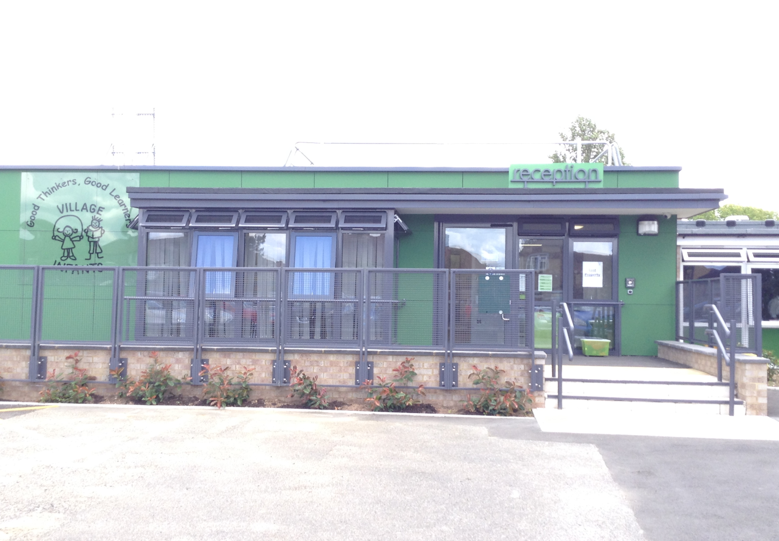
Welcome to Village Infants

Slide 2
Please see the website
If you need to contact the GB please send a letter to the school office addressed to the Chair of Governors: Ms Jo Archer
Governing Board

Slide 3
Safety
To keep children safe please do not:
Park in the drive
Smoke on school premises
Send your child to school wearing jewellery – apart from a watch and stud earrings
Also –
Remember to let us know when you change your mobile number
Remember to let child minders know your security password
Remember to keep your child with you so they do not get lost
Keep children with you whilst on school grounds

Slide 4
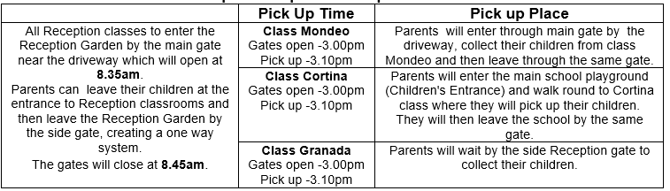
School Times
Reception Drop Off/Pick Up Times and Place

Slide 5
Starting in September
Stay and Play with Parents
Tuesday 12th September
Half Day (either am or pm)
Wednesday 13th, Thursday 14th, Friday 15th September
All Children stay for mornings + lunch
Monday 18th, Tuesday 19th and Wednesday 20thSeptember
(On these days the gates open at 8.35am for an 8.45am start and you
can collect your child at 1.30pm)
Full Time
From Thursday 21st September
Gates open 8.35am for 8.45am start. Pick up is at 3.10pm
All these details will be in your induction pack

Slide 6
Please note that if your child needs more support with transition we will accommodate their needs with a personal timetable towards full time

Slide 7
Attendance Facts
Good attendance (95%) helps children make good progress in their learning and enjoy happy and confident relations with others.
This also applies to good punctuality. If a child arrives in their class late they can often feel anxious because they arrive in a class where the lesson has already begun.
If you decide your child is not well enough to attend school you should inform the school office by 9am on the first day of your child’s absence.
Please take an Attendance leaflet before you leave.
Please see the Attendance Policy, in School Policies, on the School Website for more information.

Slide 8
School Meals
All infant children are entitled to a free hot school meal. If you prefer you can prepare your child a healthy packed lunch for them to bring into school.

Slide 9
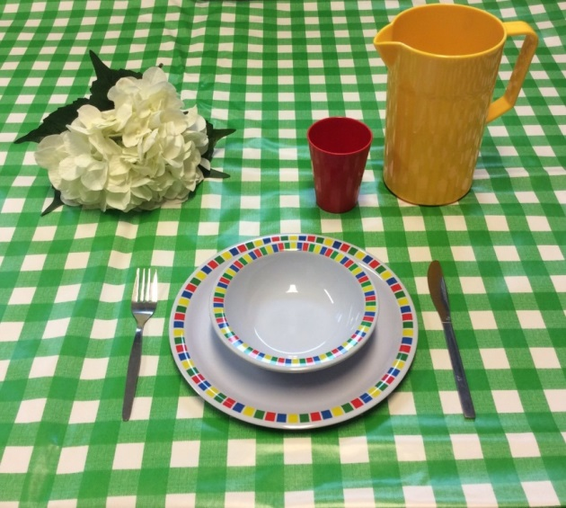
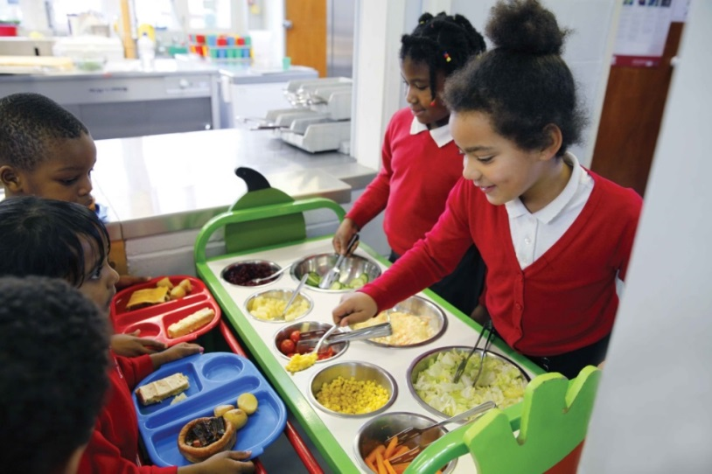
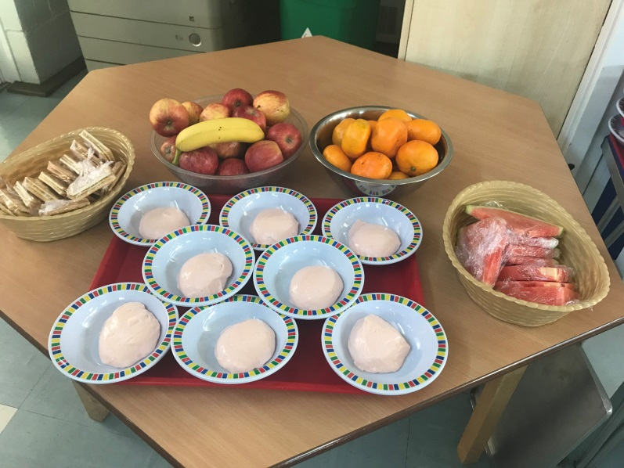
School Meals…..Free hot dinner for every child

Slide 10
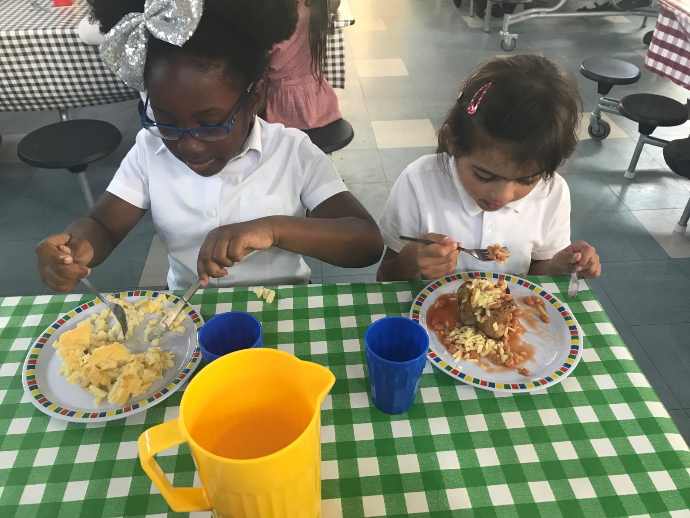
We expect children to use a knife and fork!

Slide 11
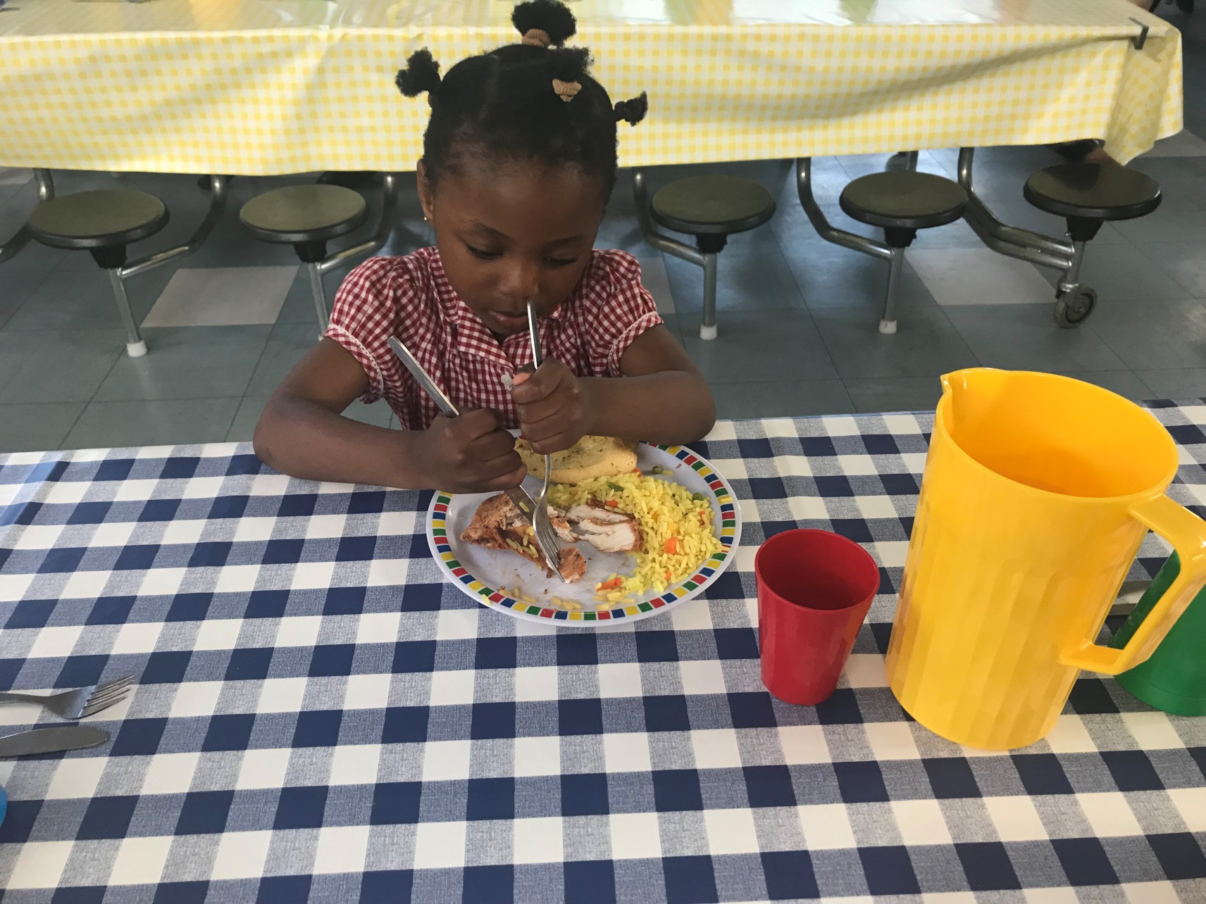
Sometimes the skill is a work in progress!

Slide 12
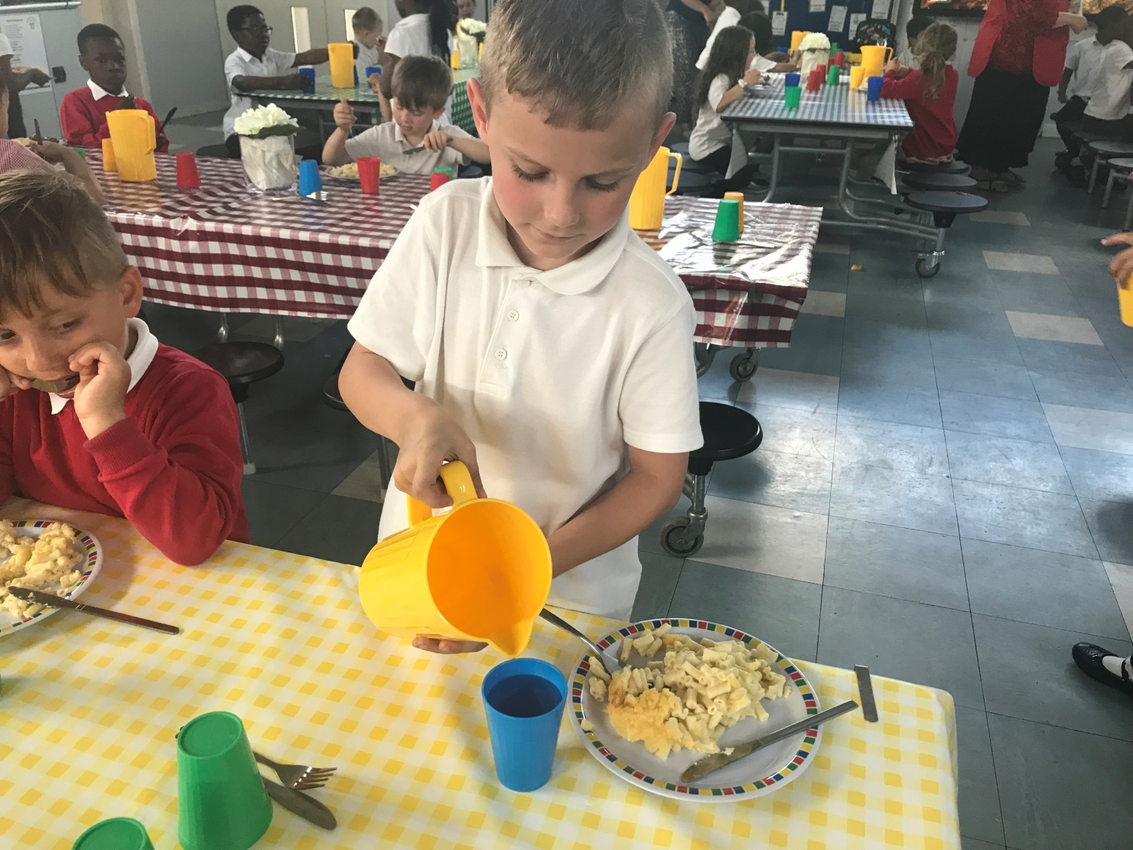
All pupils are encouraged to be independent……

Slide 13


Packed Lunch
Pack food that is healthy and your child will enjoy eating.
Please name your child’s lunch box.
The Following are NOT allowed
Fizzy drinks
Drinks in glass containers
Sweets or chocolates [chocolate biscuit based bars are ok]
Food with nuts (please do not put food with nuts in your child’s packed lunch as we have staff and children with a severe nut allergy)

Slide 14
School Uniform and PE Kit
Please
………NAME EVERYTHING
No rucksacks – only book bags please
See the school brochure for details of what to buy and where
Children will not need PE kit until after October half Term…. Class teacher will let you know what colour T Shirt to buy

Slide 15
School Shoes
Black shoes or trainers must have velcro – no laces are allowed until children can do them themselves.

Slide 16
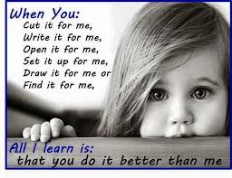
Do you help your child too much?

Slide 17
Ready for Reception checklist…

Slide 18
I can go to the toilet on my own.
I can wash and dry my hands on my own.
I can eat with a fork.
I can cut food with a knife and fork.
I can take a jumper or cardigan off and put it back on.
I can do up buttons.
I can do up a zip.
I can put my coat on and do it up.
I can take my shoes on and off.
I can undo my shoes and do them up (Velcro NOT laces).

Slide 19
I can take my socks off and put them back on.
I can take my tights or leggings off and put them back on.
I can listen to a story.
I can answer simple questions about the story.
I can recognise my name.
I can ask for help when needed.
I can talk about myself and my family.
I can draw a picture and talk about it.
I can cut safely using scissors.

Slide 20
A Question!
What four things can you do over the summer to help prepare your child for school?

Slide 21
Read to them
Talk with them
Play with them
Let them make mistakes

Slide 22
At Village Infant we encourage children to think with a
Growth Mindset
The message we want to give our children is that you can grow your intelligence, grow your talents and become smarter.
We want them to say “I can’t do that yet”
We want them to feel OK about making mistakes because that is how they learn.

Slide 23
Village Core Values are…
Perseverance…. Helps us to keep doing something even when it is difficult.
Resilience…. Helps us to feel OK about making mistakes.
Kindness…. Makes us friendly and considerate of other
people’s feelings.
Curiosity …… Makes us eager to learn and ask questions.

Slide 24
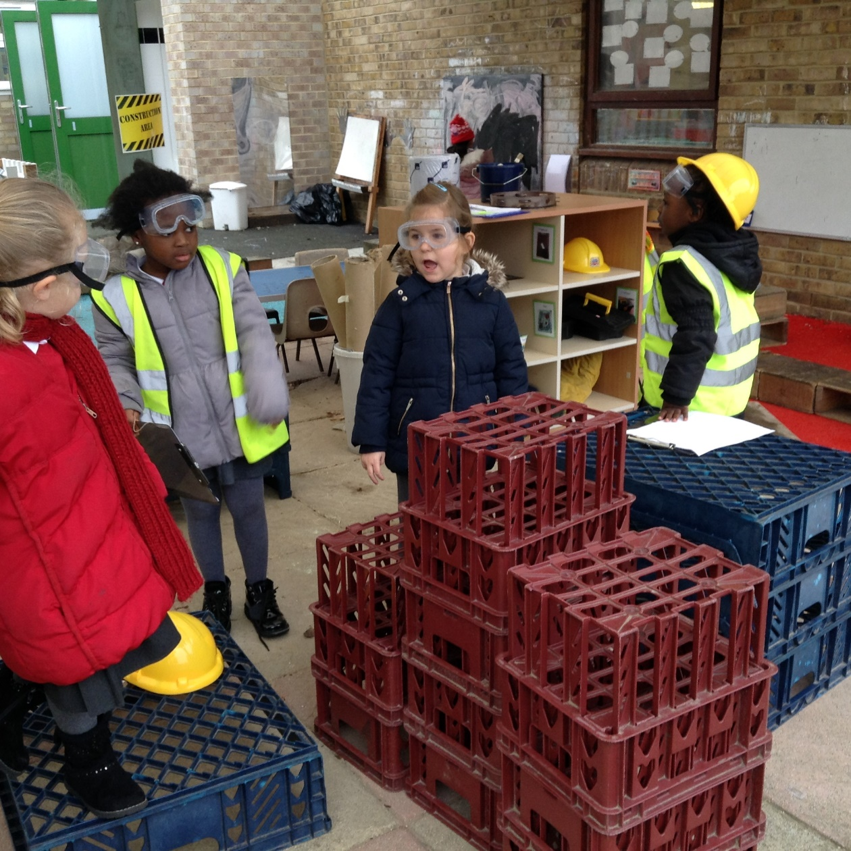
Perseverance … Resilience … Curiosity…. Kindness

Slide 25
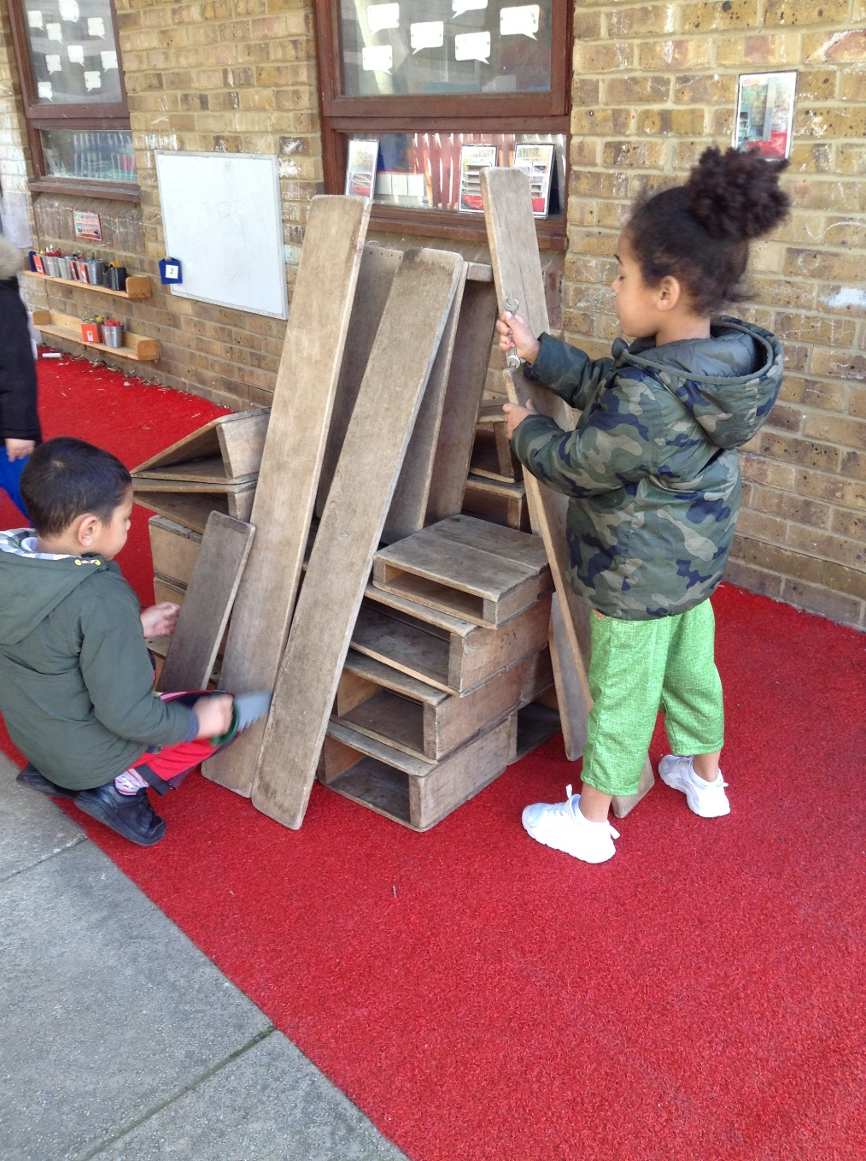
Perseverance … Resilience … Curiosity…. Kindness

Slide 26
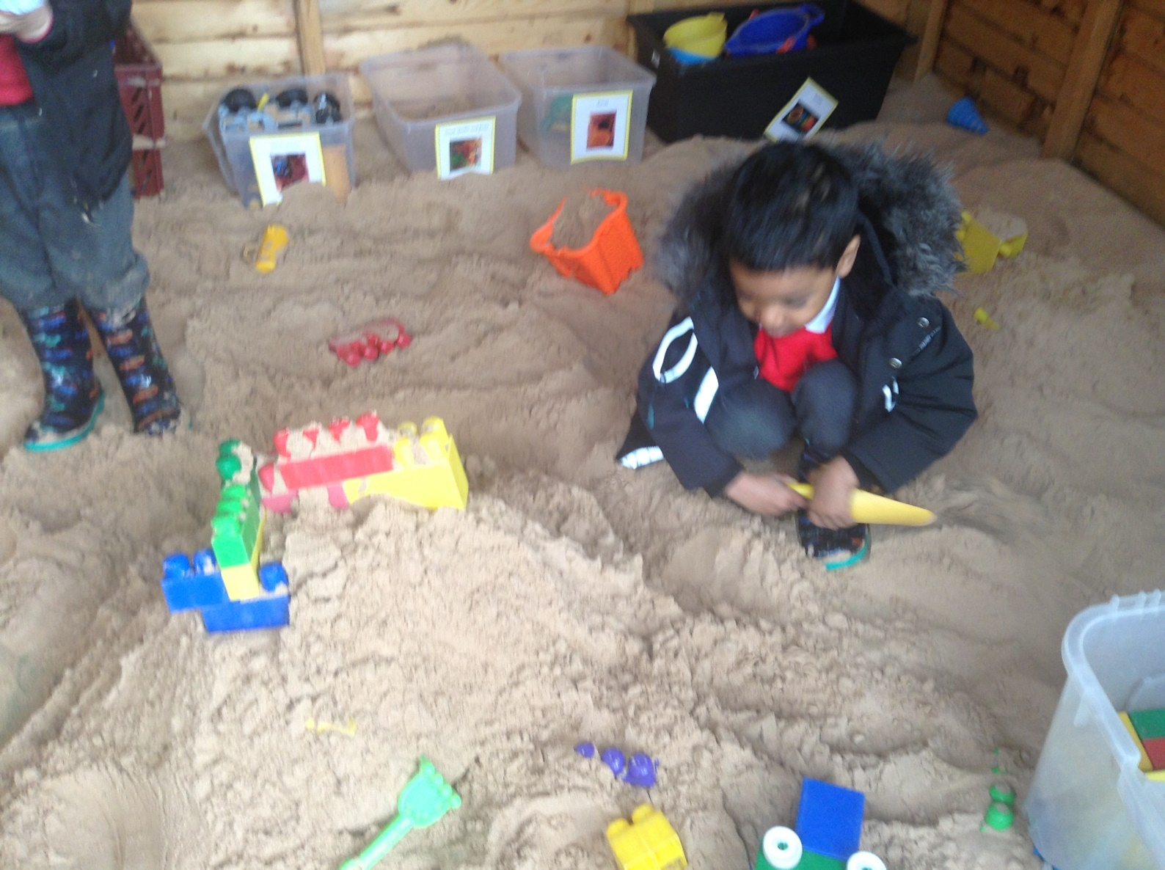
Perseverance … Resilience … Curiosity…. Kindness

Slide 27
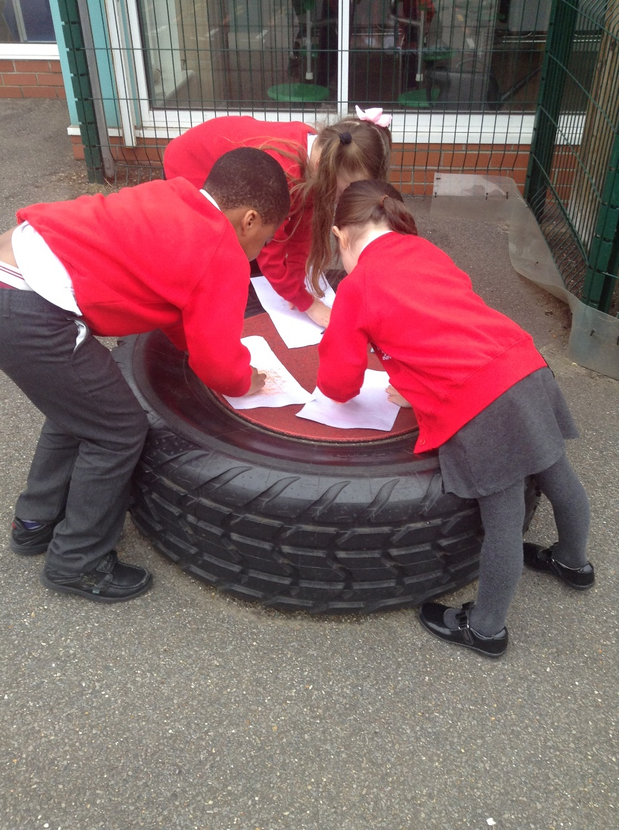
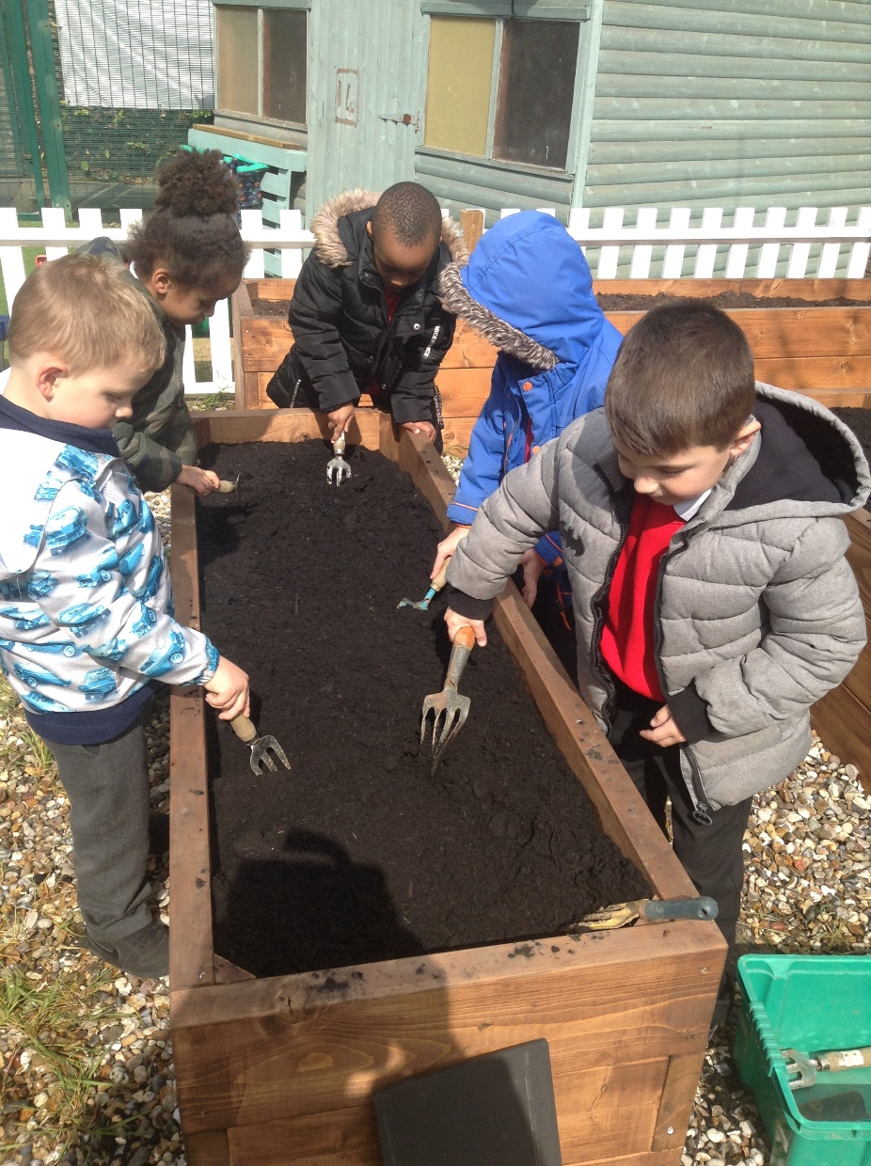
Perseverance … Resilience … Curiosity…. Kindness

Slide 28
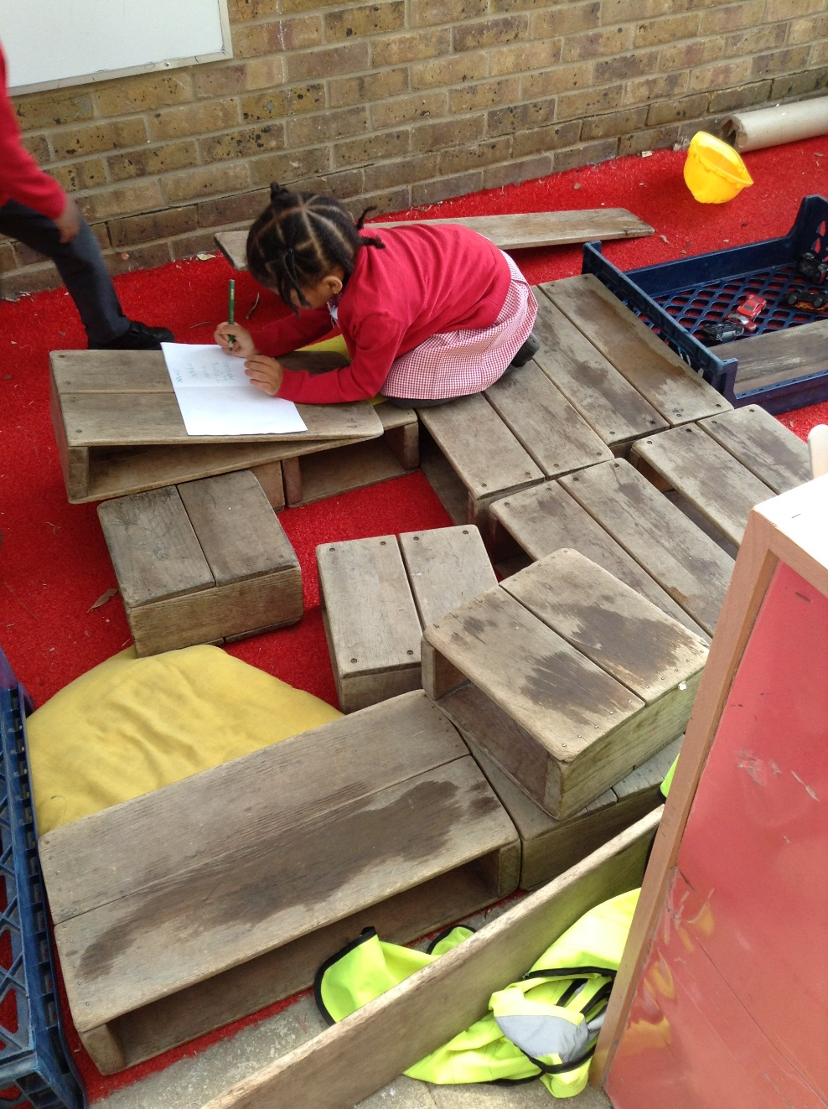
Perseverance … Resilience … Curiosity…. Kindness

Slide 29
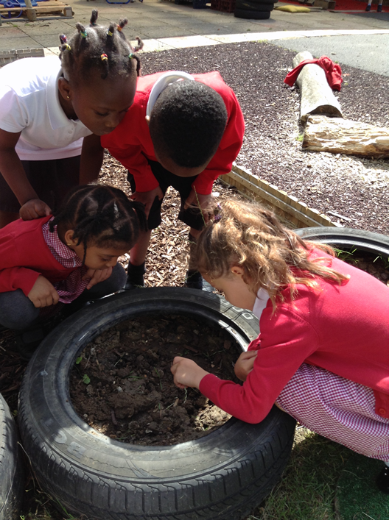
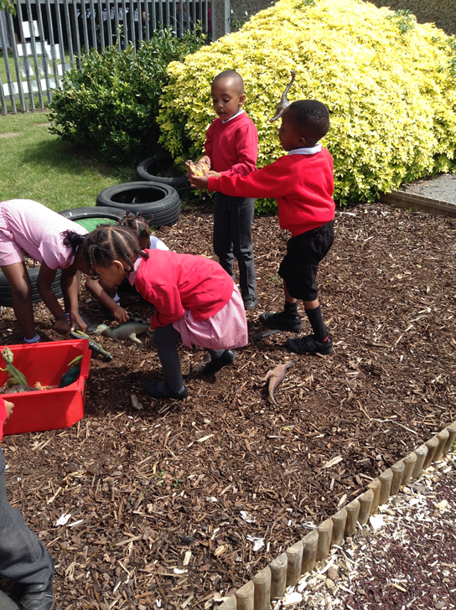
Perseverance … Resilience … Curiosity…. Kindness

Slide 30
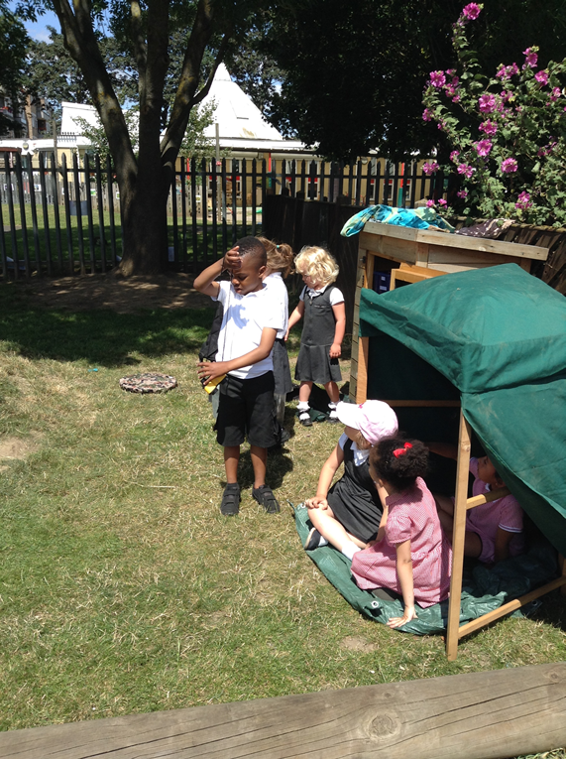
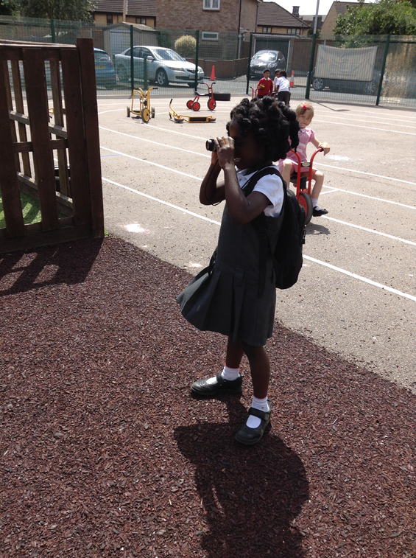
Perseverance … Resilience … Curiosity…. Kindness

Slide 31
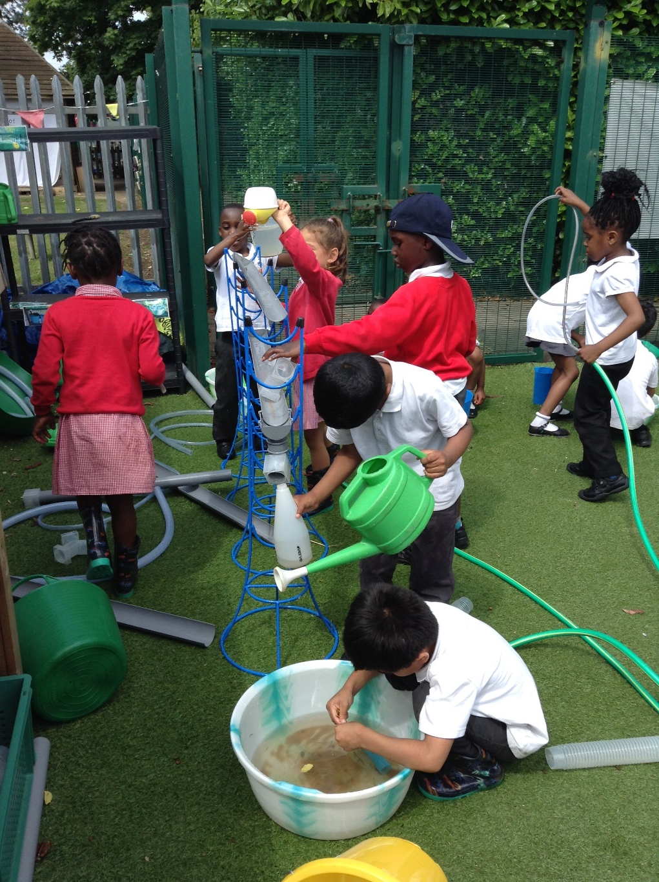
Perseverance … Resilience … Curiosity…. Kindness

Slide 32
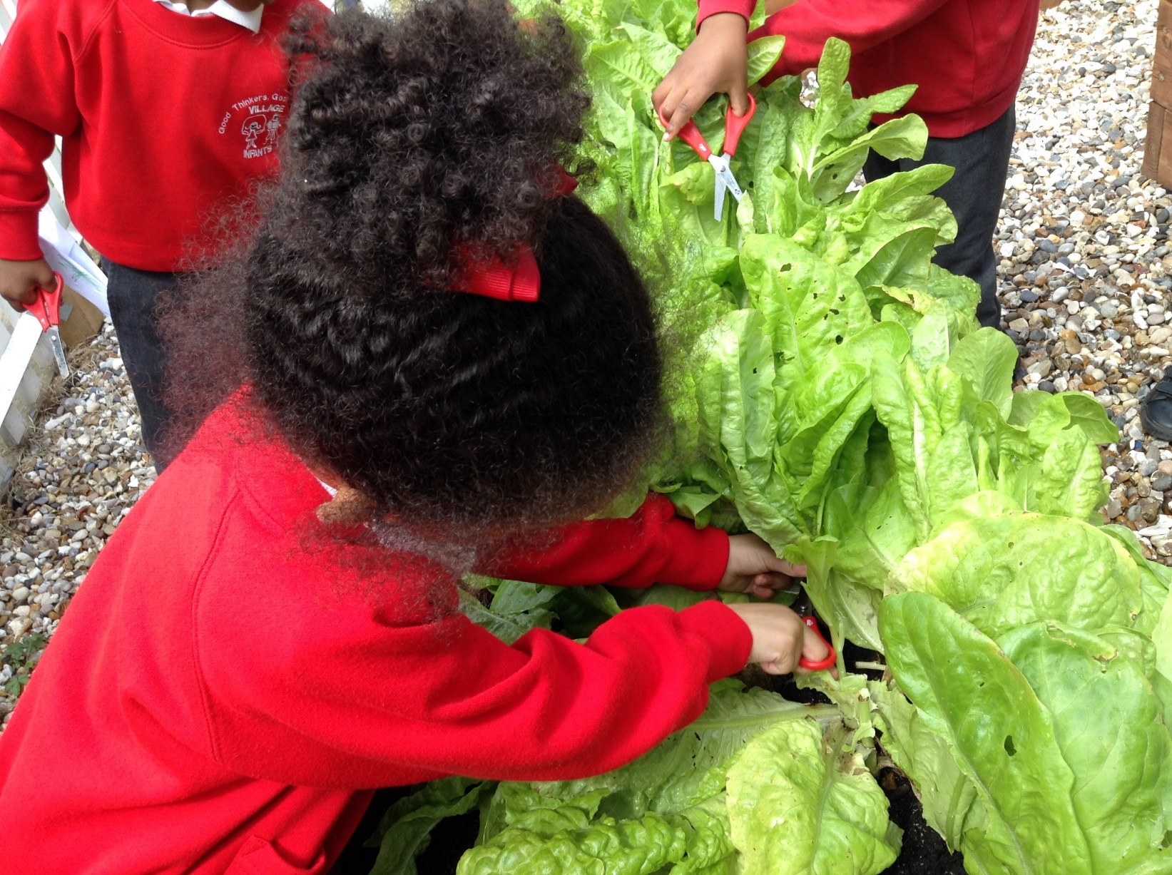
Perseverance … Resilience … Curiosity…. Kindness

Slide 33
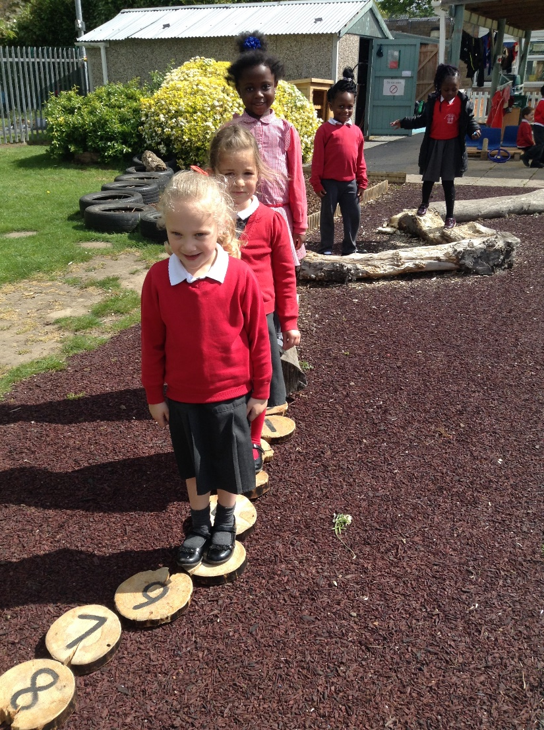
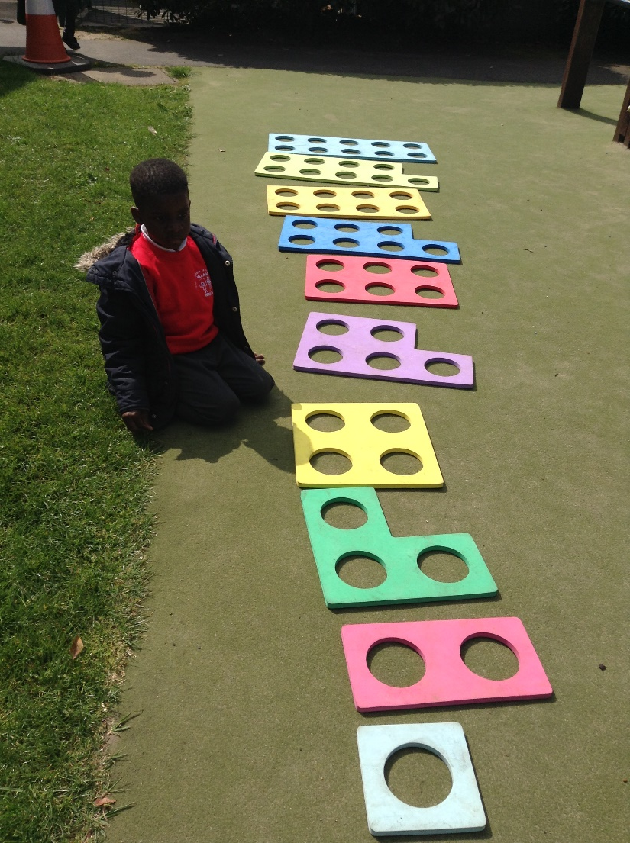
Maths

Slide 34
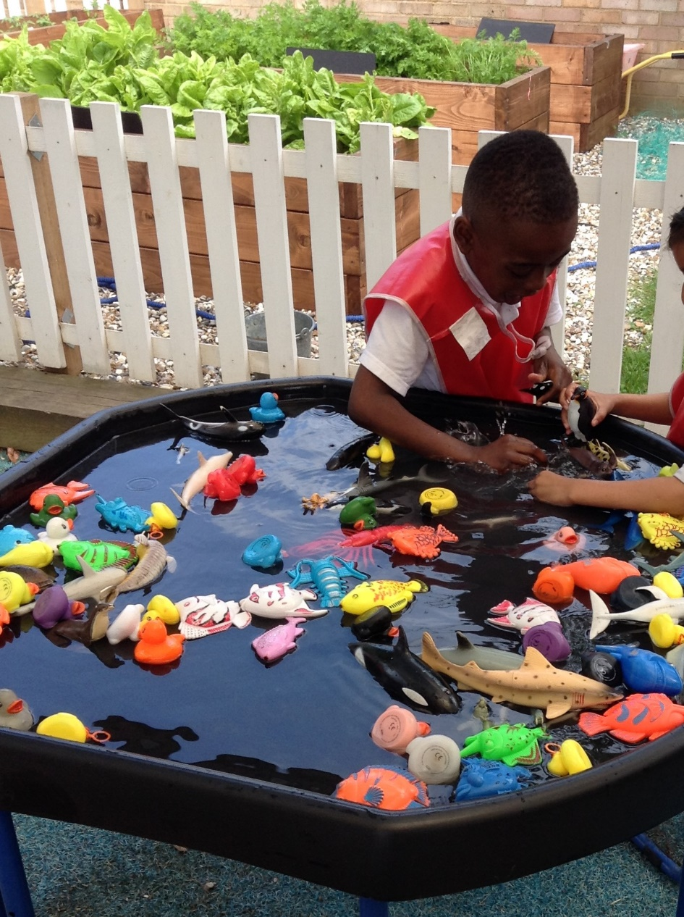
Perseverance … Resilience … Curiosity…. Kindness

Slide 35
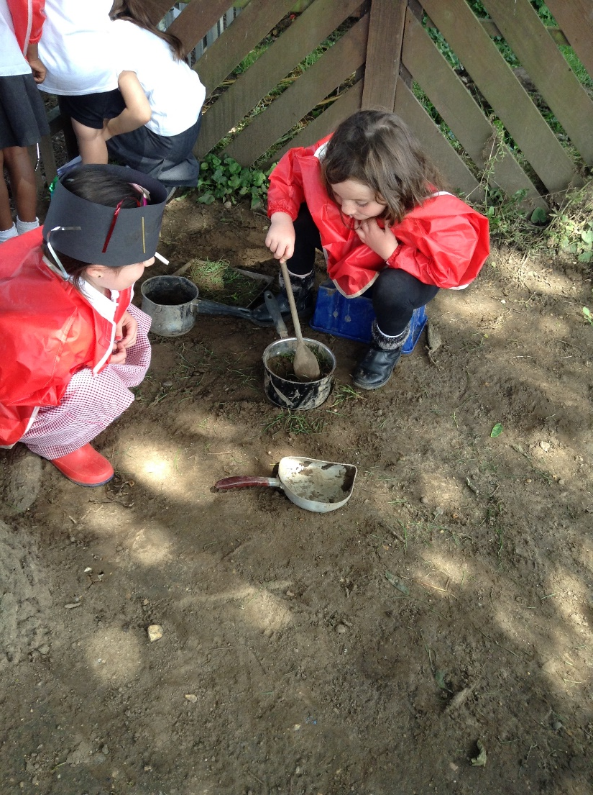
Outdoor Play
The garden is a learning zone…
Clothes might get dirty!!
Please bring in spare clothes and wellies in a carrier bag so children can access this in all weathers.

Slide 36
Behaviour Rules
Kind hands
Kind feet
Kind words
Look after things
Tell the truth

Slide 37

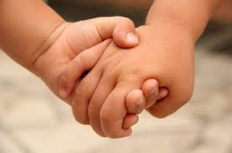
Be Kind
Kind Words
Kind Hands and Feet

Slide 38

Tell the Truth

Slide 39

Try Your Best

Slide 40
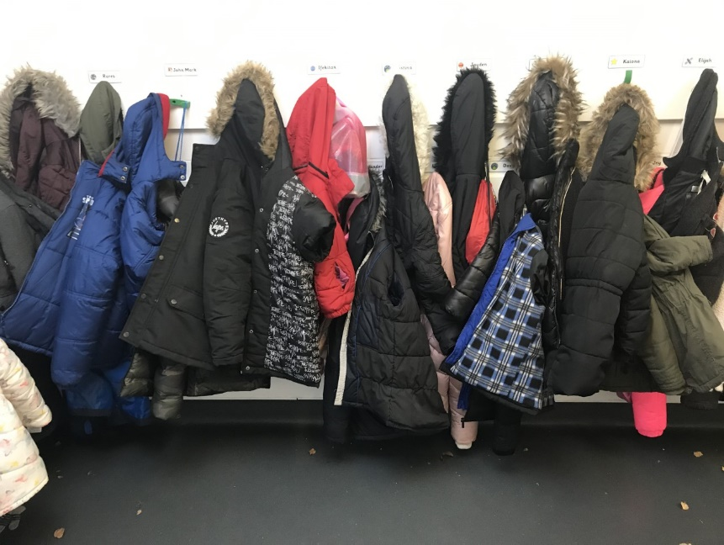
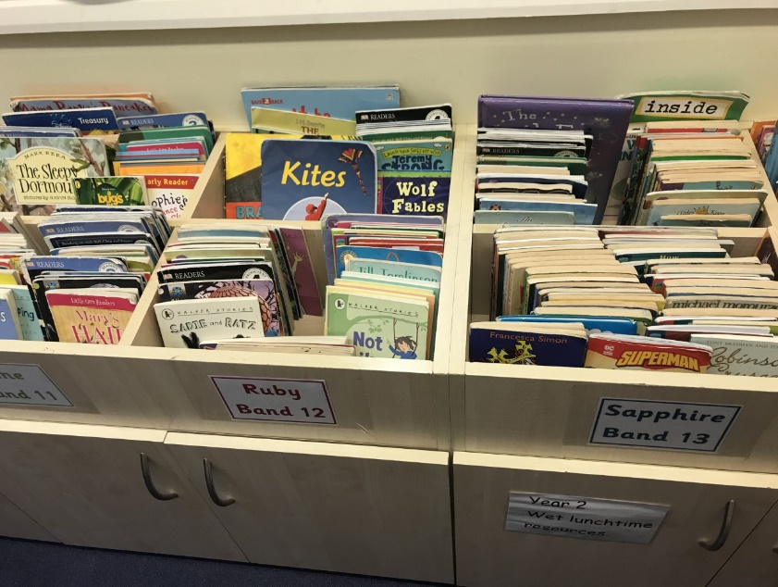
Look after Things

Slide 41
Safeguarding
Schools have a Duty of Care to all children. If you child discloses anything that suggests they are at risk of harm– we have to report to the Local Authority
E Safety – Young people have an entitlement to safe internet access. An acceptable use agreement was attached to the enrolment form and additional information can be found in the E Safety policy on the school website.
The school believes in responsible use of children’s images. An acceptable use agreement was attached to the enrolment form.
School trips:
Local walking visits eg to the park or church – a permission form was attached to the enrolment form.
Public transport or coach – a consent form will be sent to you at time of trip.
First Aid procedures – Permission was given on enrolment form for your child to receive first aid. See School Brochure for more details.

Slide 42
The following slides show children who are enjoying developing our core values:
Perseverance
Resilience
Curiosity
Kindness

Slide 43
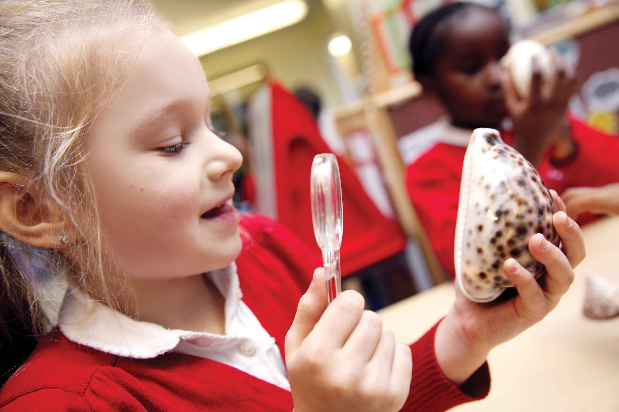

Slide 44
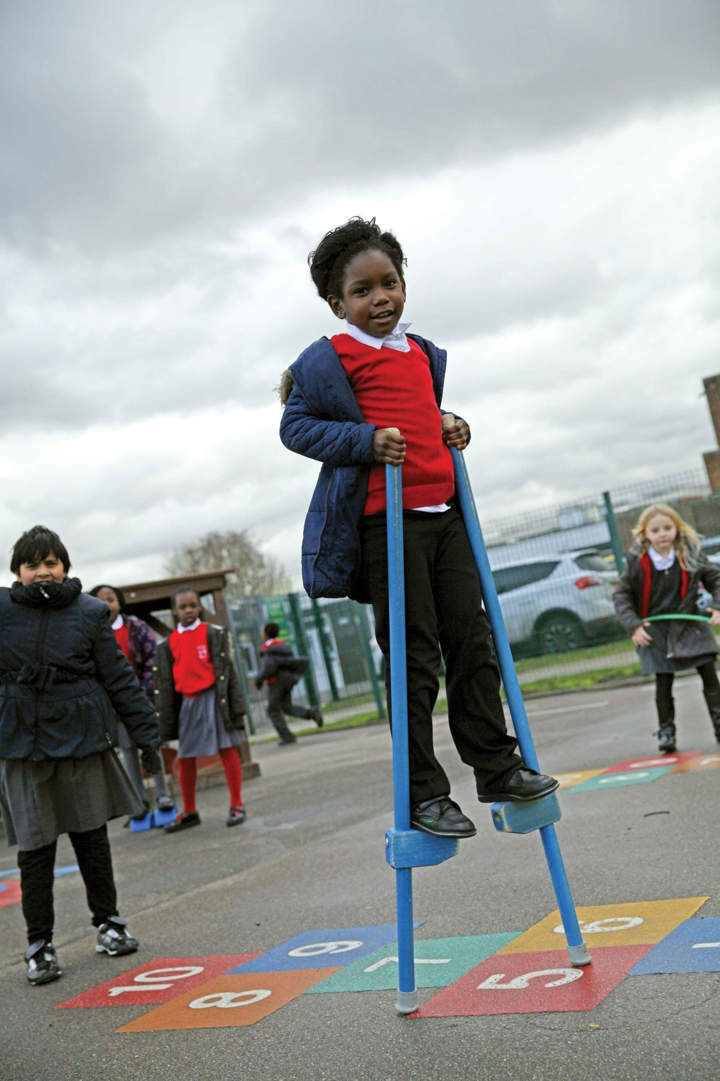

Slide 45


Slide 46
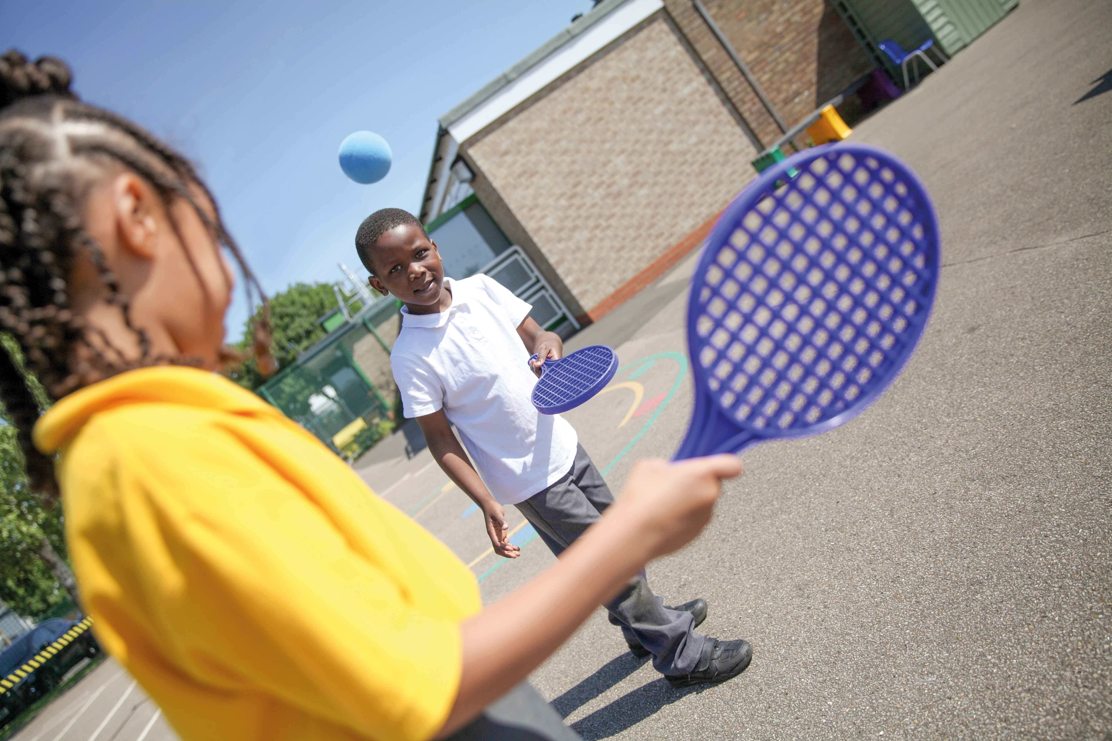

Slide 47
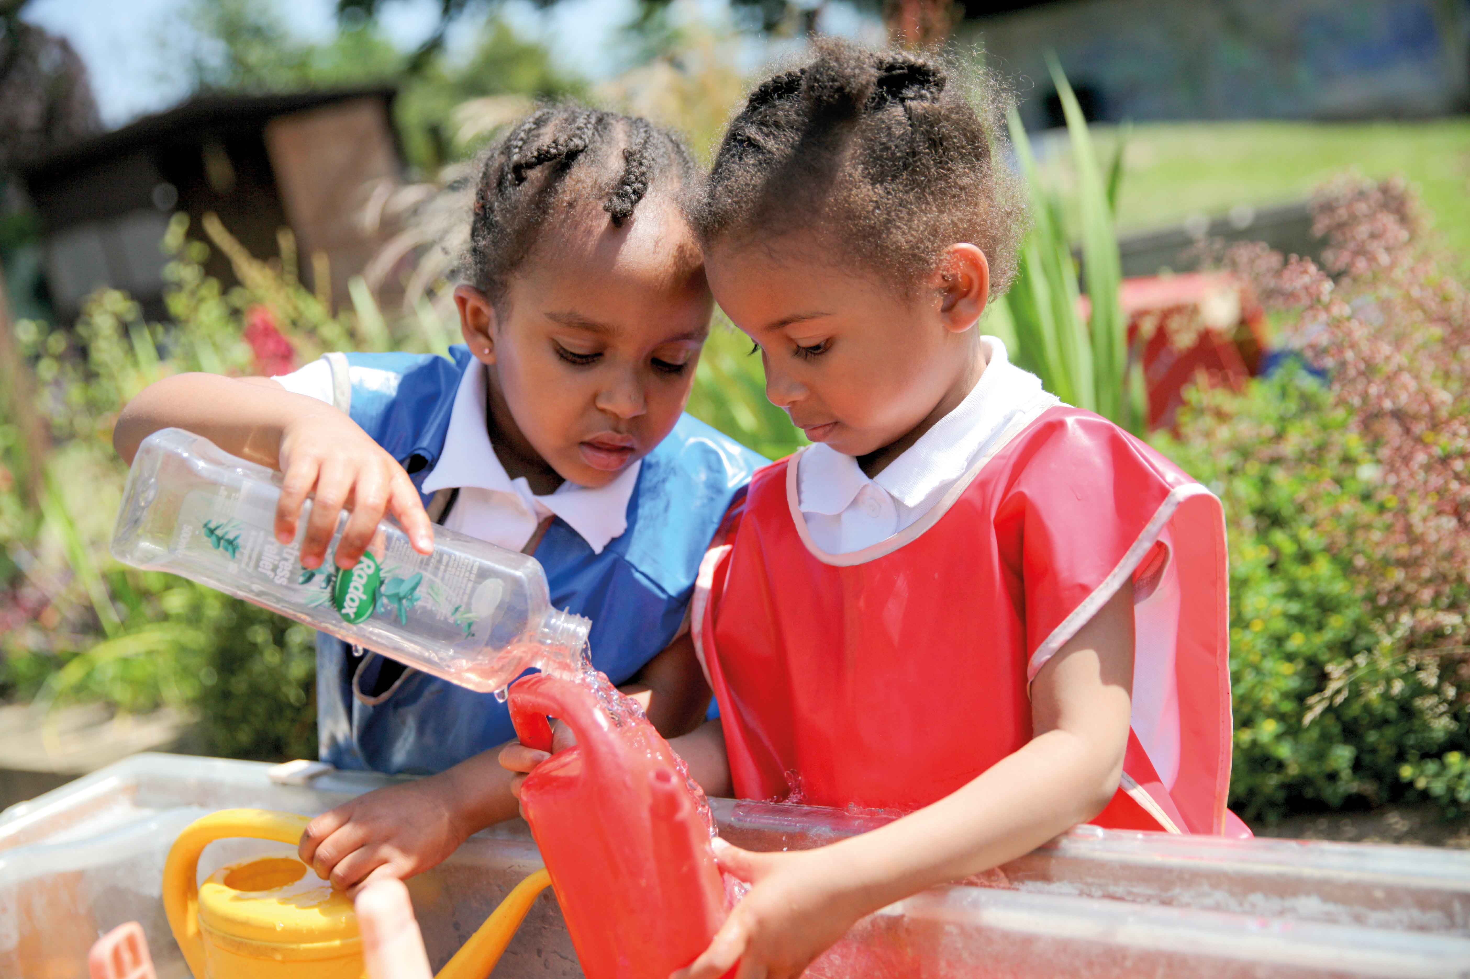

Slide 48


Slide 49


Slide 50
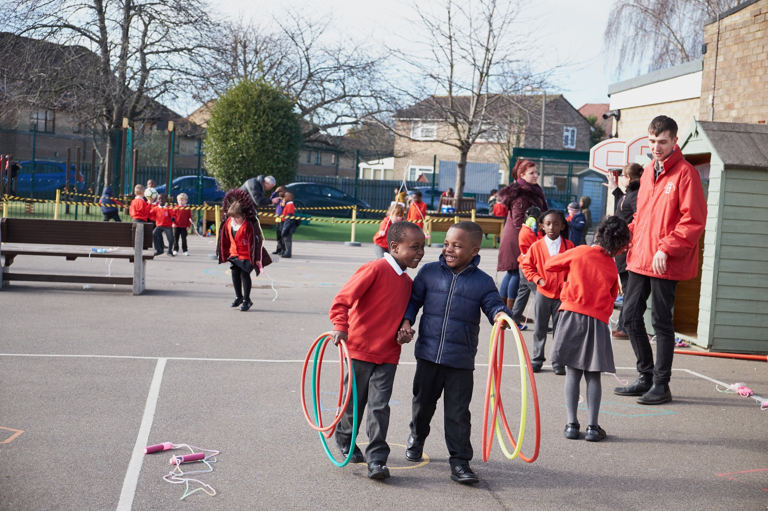

Slide 51
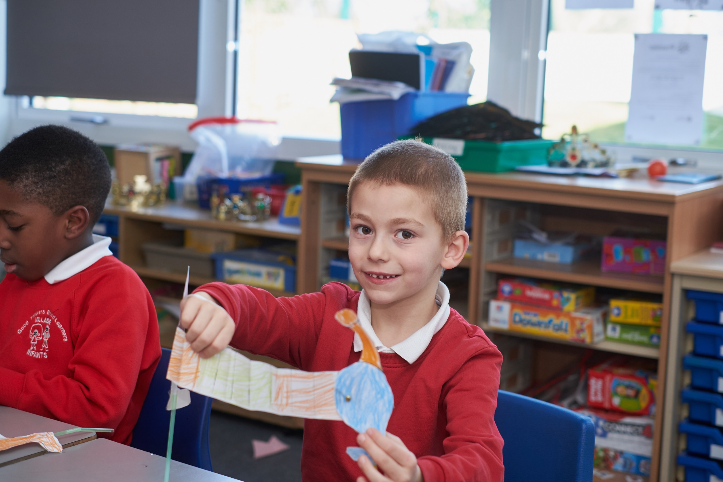

Slide 52
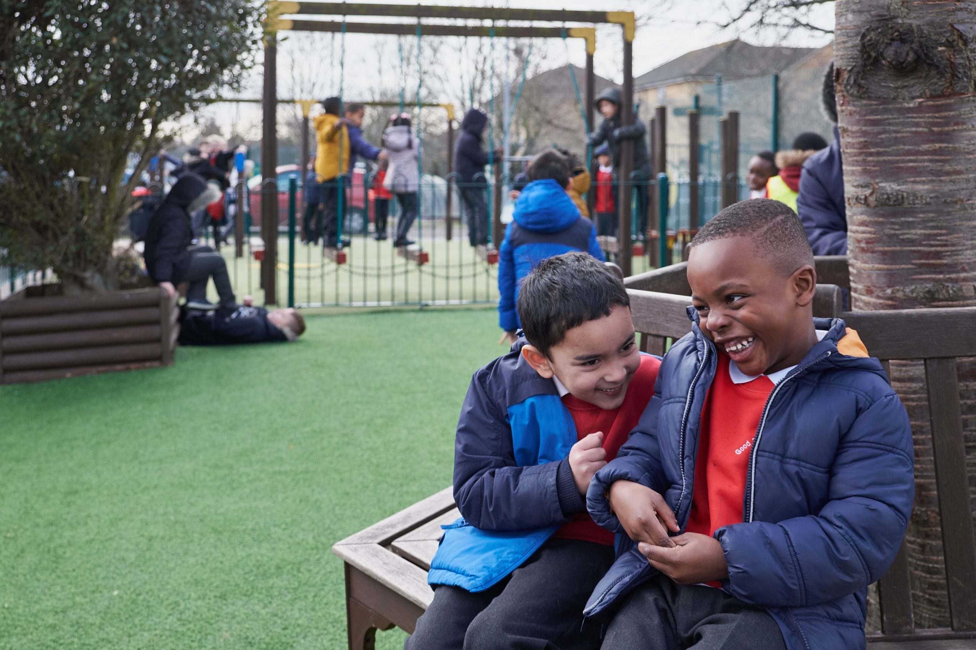

Slide 53


Slide 54
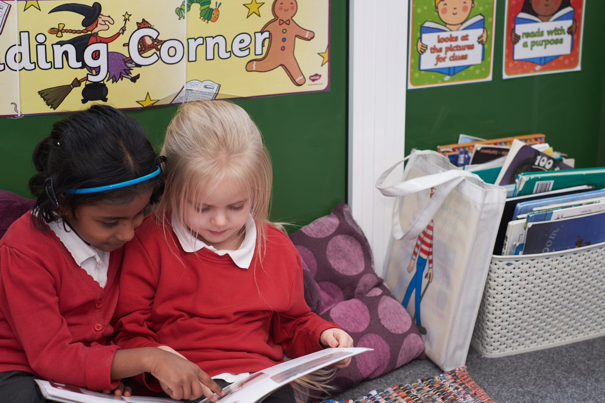

Slide 55


Slide 56
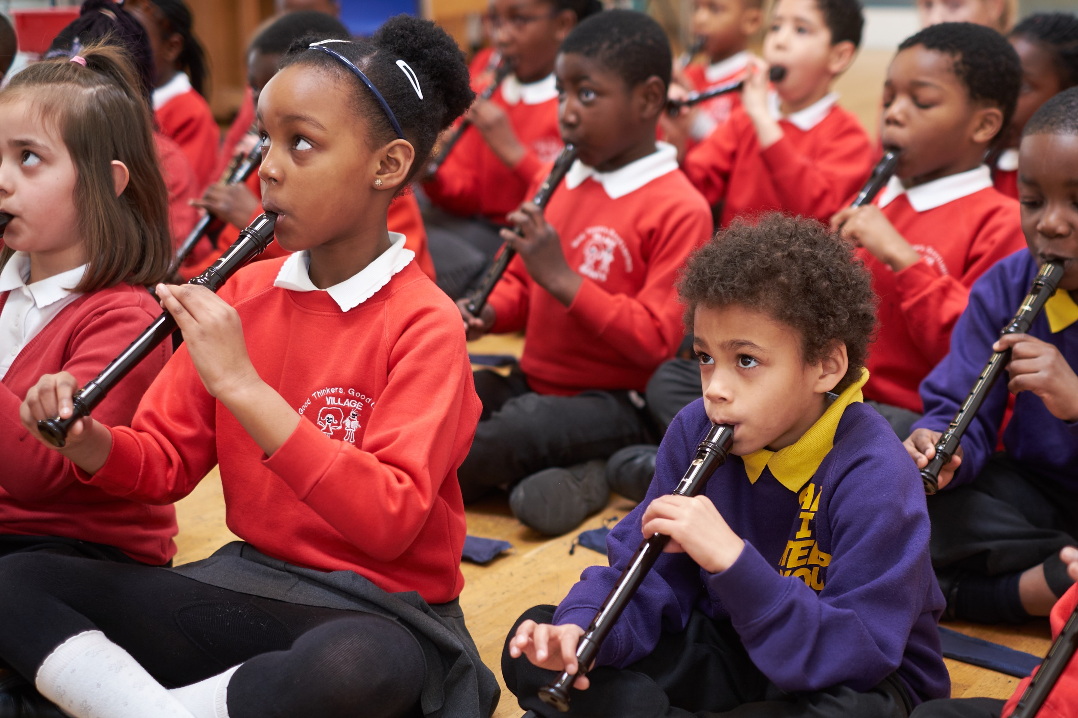

Slide 57


Slide 58


Slide 59


Slide 60
Learning is fun….
We are looking forward to having fun with you and your child
Please help them to be ready to have fun by making sure they:
Are not tired or hungry
Can talk
Can listen
Can play

Slide 61
Thank you for reading!
If you have any questions please email the school office
office@village.bardaglea.org.uk

